Slide 1
Enrolment scenarios
Version 1.0.1 | August 2025

Slide 2
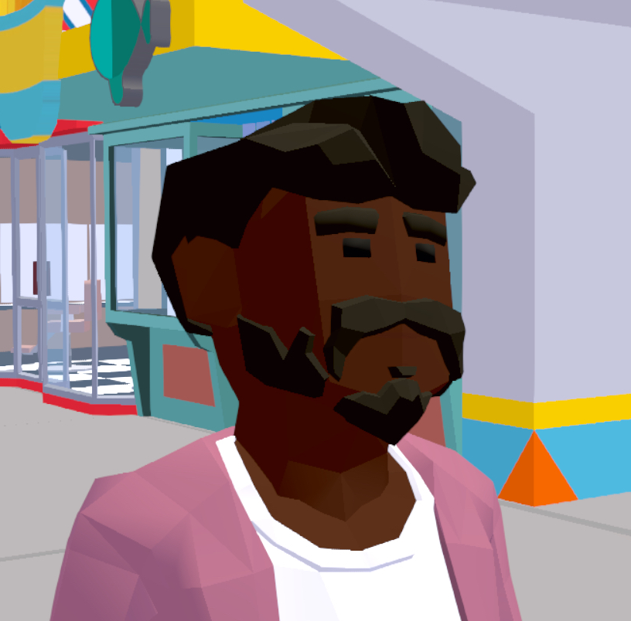
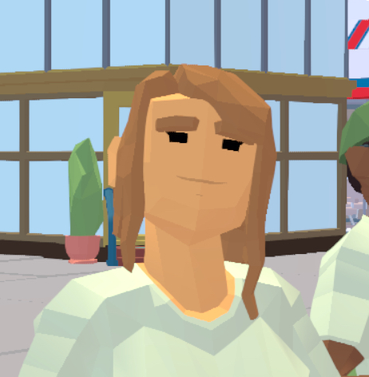
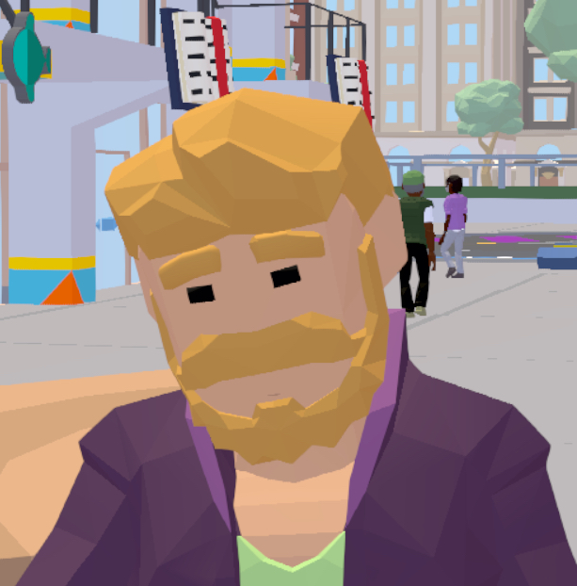
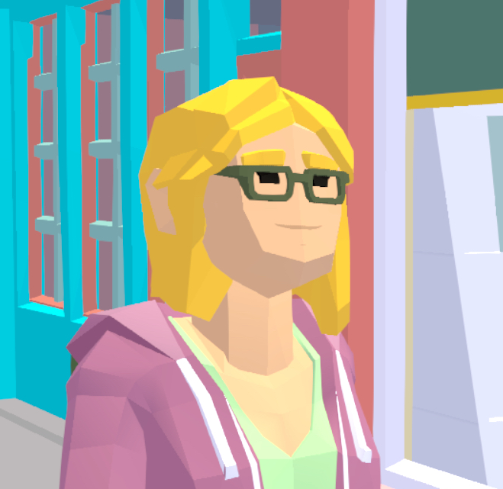
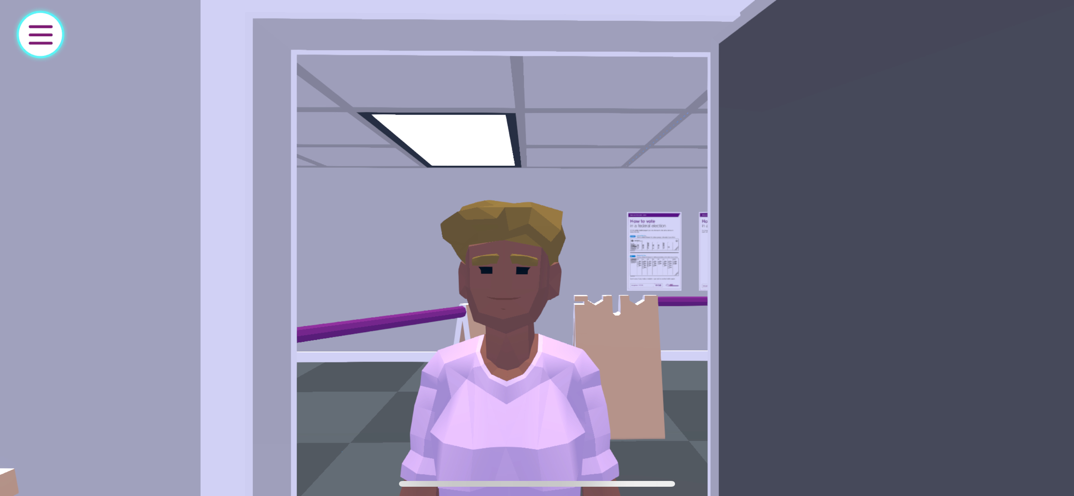
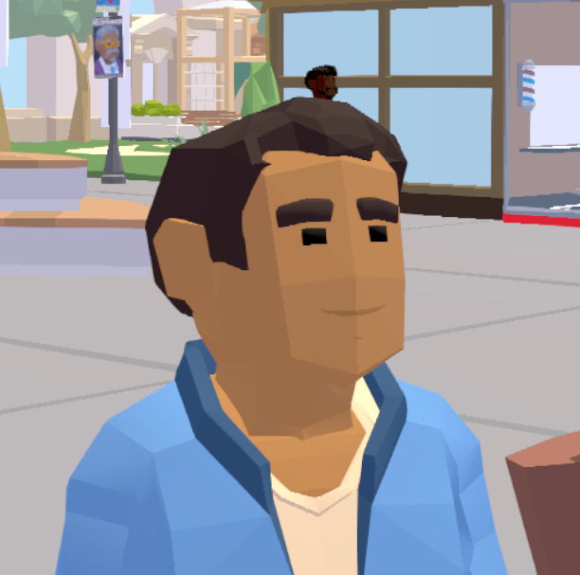
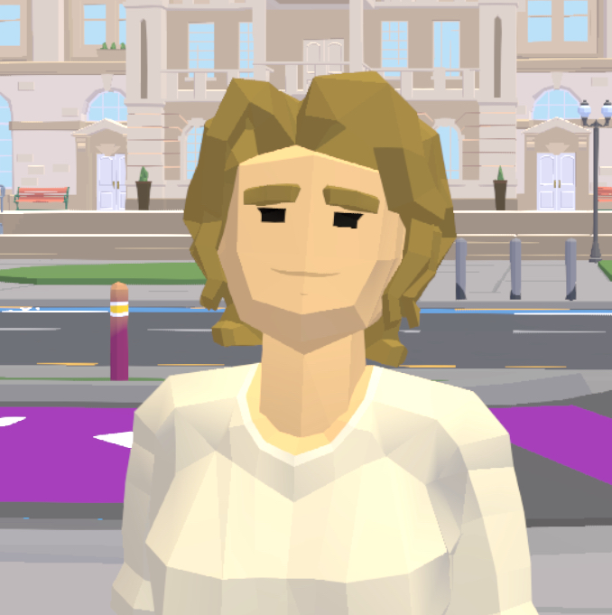
Enrolment scenarios
Suraj
Izzy
Tyler
Madison
Bailey
RJ
Sinead
I am in my first year at university and am going to be 18 before the next election. What should I do? | I am an American citizen and a permanent Australian resident. I don’t plan on becoming a citizen any time soon though. Can I enrol for the next federal election? | I have just moved house. What should I do? | I am 16 years old and a dual citizen, Australian and American. What should I do before the next federal election? | My dad works as a policeman, and he does not want people to know our home address. How should I enrol? | I have an Australian passport, and I am 17 years old. What should I do? | I am a new Australian, I have just become a citizen. I am 21 years old. What should I do?

Slide 3
Answer sheet
Suraj
Izzy
Tyler
Madison
Bailey
RJ
Sinead
I am in my first year at university and am going to be 18 before the next election. What should I do? | I am an American citizen and a permanent Australian resident. I don’t plan on becoming a citizen any time soon though. Can I enrol for the next federal election? | I have just moved house. What should I do? | I am 16 years old and a dual citizen, Australian and American. What should I do before the next federal election? | My dad works as a policeman, and he does not want people to know our home address. How should I enrol? | I have an Australian passport, and I am 17 years old. What should I do? | I am a new Australian, I have just become a citizen. I am 21 years old. What should I do?
Enrol | No, I cannot enrol | Update my enrolment | Enrol | Enrol as a silent voter | Enrol | Enrol

